Slide 1
MODULE 08 BASIC AERODYNAMICS
LEVEL-2
8.4 - FLIGHT STABILITY AND DYNAMICS
Source-EASA MODULE 8
Prepared By – Pranav Thorave (HAE) PUNE

Slide 2
FLIGHT STABILITY AND DYNAMICS

Slide 3
THE AXES OF AN AIRCRAFT
Whenever an aircraft changes its attitude in flight, it must turn about one or more of three axes.
Figure 4-1 shows the three axes, which are imaginary lines passing through the center of the aircraft.
The axes of an aircraft can be considered as imaginary axles around which the aircraft turns like a wheel.
At the center, where all three axes intersect, each is perpendicular to the other two.

Slide 4
Axis
The axis that extends lengthwise through the fuselage from the nose to the tail is called the longitudinal axis.
The axis that extends crosswise from wing tip to wing tip is the lateral, or pitch, axis.
The axis that passes through the center, from top to bottom, is called the vertical, or yaw, axis.

Slide 5
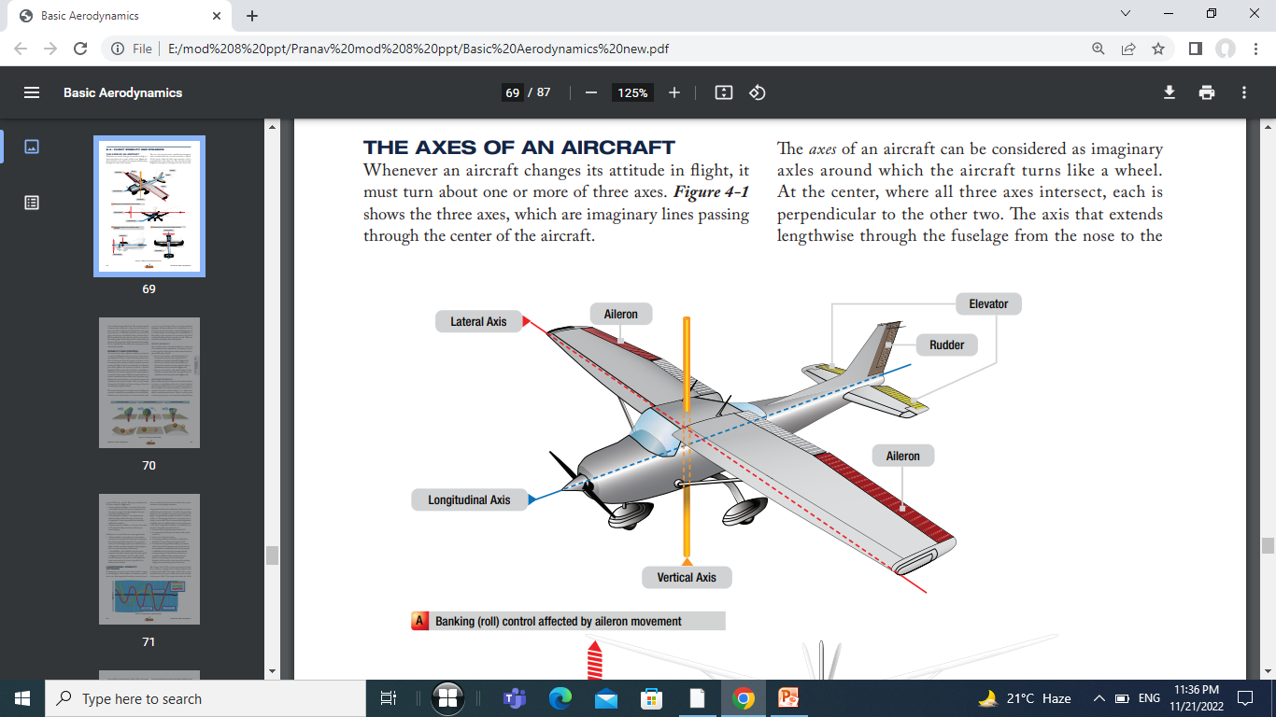

Slide 6
Roll, pitch, and yaw are controlled by three control surfaces.
Roll is produced by the ailerons, which are located at the trailing edges of the wings.
Pitch is affected by the elevators, the rear portion of the horizontal tail assembly.
Yaw is controlled by the rudder, the rear portion of the vertical tail assembly.

Slide 7
Stability
In level flight, whenever an aircraft is disturbed the reaction of the aircraft to the disturbance, will depend on the level of stability that an aircraft possesses. The stability of an aircraft therefore, is the natural tendency of an aircraft to return to its level flight position following a disturbance without any assistance or inputs from the pilots.
Stability therefore occurs whenever an aircraft is rotated about any one or a combination of its three axes

Slide 8
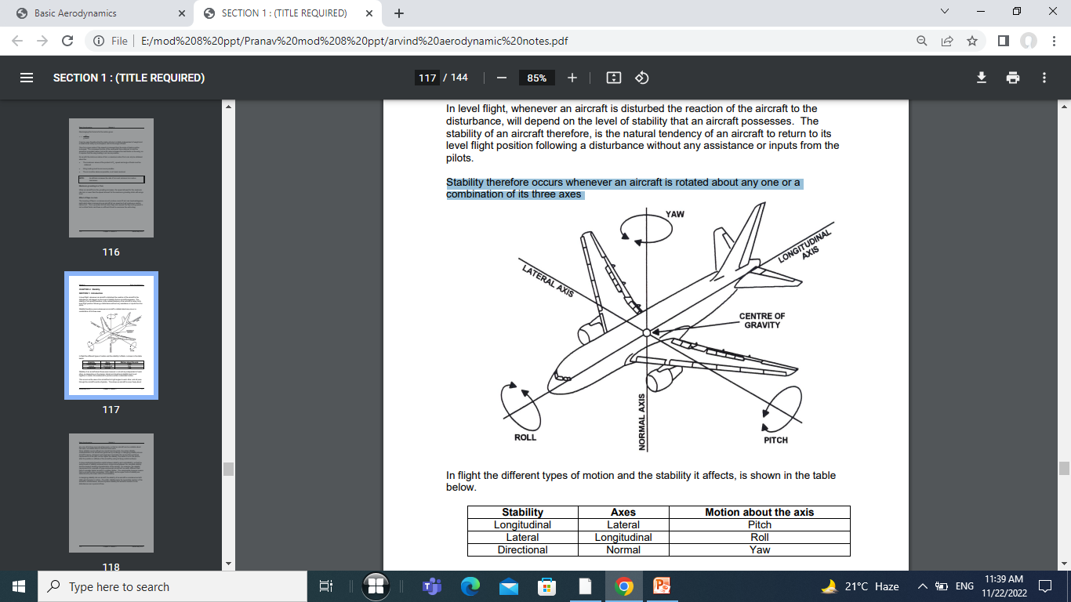

Slide 9
Static Stability
Static Stability of an Aircraft
The static stability of an aircraft, is considered to be either positive, negative or neutral and is the initial tendency an aircraft displays after it has been disturbed from its given equilibrium position.
If an aircraft moves back towards its original position after a disturbance, it is said to be statically stable or have positive stability.
If however it continues to move in the direction of the displacement it is said to be statically unstable or have negative stability

Slide 10
if it tends to remain in the disturbed position, neither moving back towards its original position or away from it, it is said to be statically neutral or have neutral static stability.
The type of static stability of an aircraft can experience, being easily demonstrated by using a ball and a curved container.

Slide 11
STABILITY AND CONTROL
An aircraft must have sufficient stability to maintain a uniform flight path and recover from the various upsetting forces.
Also, to achieve the best performance, the aircraft must have the proper response to the movement of the controls.
Control is the pilot action of moving the flight controls, providing the aerodynamic force that induces the aircraft to follow a desired flight path.

Slide 12
When an aircraft is said to be controllable, it means that the aircraft responds easily and promptly to movement of the controls.
Different control surfaces are used to control the aircraft about each of the three axes.
Three terms that appear in any discussion of stability and control are: stability, maneuverability, and controllability.

Slide 13
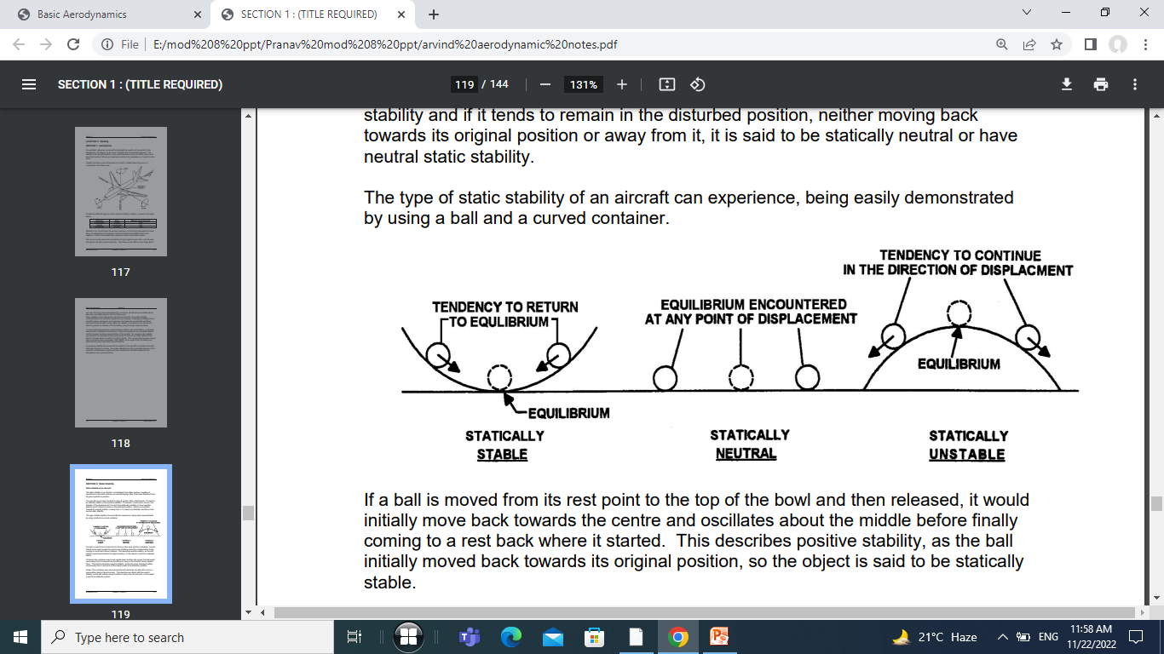

Slide 14
If a ball is moved from its rest point to the top of the bowl and then released, it would initially move back towards the center and oscillates about the middle before finally coming to a rest back where it started. This describes positive stability, as the ball initially moved back towards its original position, so the object is said to be statically stable.

Slide 15
If however the container was turned upside down and the ball moved, the ball would move away from its rest point and continue to move in the direction of any applied force. This motion describes negative stability, as the ball when disturbed initially moved away from it rest point so the object is said to be statically unstable.

Slide 16
Finally if the container was removed and the ball disturbed, the ball will move to a new position where it would remain. This describes an object with the neutral stability, as the ball neither moves towards or away from its rest point, so the object is said to be statically neutral.

Slide 17
Stability is the characteristic of an aircraft that tends to cause it to fly (hands off) in a straight-and-level flightpath.
Maneuverability is the characteristic of an aircraft to be directed along a desired flightpath and to withstand the stresses imposed.
Controllability is the quality of the response of an aircraft to the pilot's commands while maneuvering the aircraft.
There are two kinds of stability, static and dynamic.

Slide 18
STATIC STABILITY
Static stability refers to the initial tendency, or direction of movement, back to equilibrium. In aviation, it refers to the aircraft's initial response when disturbed from a given AOA, slip, or bank.

Slide 19
• Positive static stability—the initial tendency of the aircraft to return to the original state of equilibrium after being disturbed (Figure 4-2)
• Neutral static stability—the initial tendency of the aircraft to remain in a new condition after its equilibrium has been disturbed (Figure 4-2)
• Negative static stability—the initial tendency of the aircraft to continue away from the original state of equilibrium after being disturbed (Figure 4-2)

Slide 20
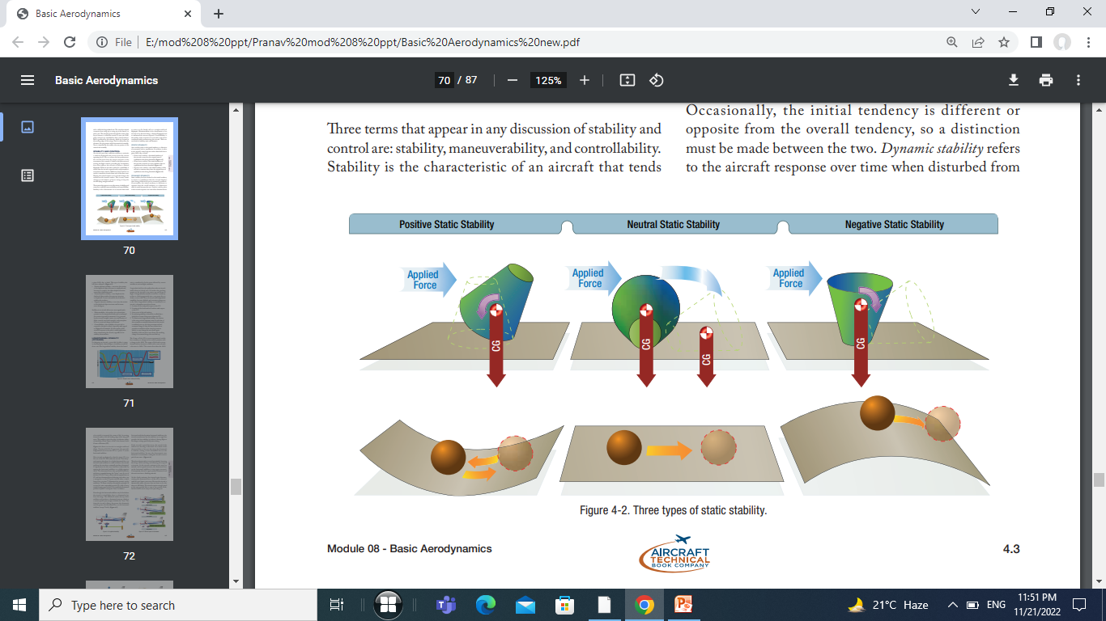

Slide 21
DYNAMIC STABILITY
Static stability has been defined as the initial tendency to return to equilibrium that the aircraft displays after being disturbed from its trimmed condition.
Occasionally, the initial tendency is different or opposite from the overall tendency, so a distinction must be made between the two.
Dynamic stability refers to the aircraft response over time when disturbed from a given AOA, slip, or bank. This type of stability also has three subtypes: (Figure 4-3)

Slide 22
Dynamic Stability
Dynamic stability of an aircraft is the movement of an aircraft after a disturbance in response to its static stability with respect to time. For example, an aircraft that is statically stable will after a disturbance, try to return to its original position but more than likely will overshoot

Slide 23
Dynamically Unstable – the oscillations are divergent with the amplitude of the oscillations increasing over time.
Dynamically Neutral – the oscillations are undamped, so the amplitude of the oscillations stays constant with time.
Dynamically Stable - the oscillations are damped, so the amplitude of the oscillations decreases with time.

Slide 24
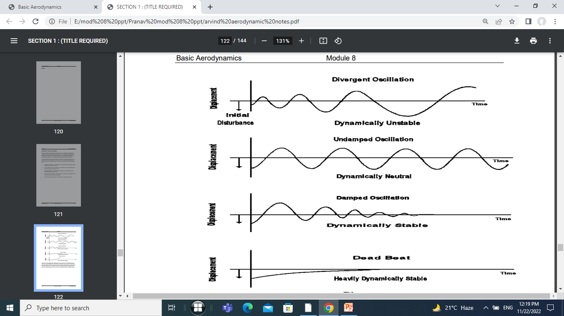

Slide 26
• Positive dynamic stability - over time, the motion of the displaced object decreases in amplitude and, because it is positive, the object displaced returns toward the equilibrium state.
• Neutral dynamic stability - once displaced, the displaced object neither decreases nor increases in amplitude. A worn automobile shock absorber exhibits this tendency.
• Negative dynamic stability - over time, the motion of the displaced object increases and becomes more divergent.

Slide 27
Stability in an aircraft affects two areas significantly:
• Maneuverability - the quality of an aircraft that permits it to be maneuvered easily and to withstand the stresses imposed by maneuvers. It is governed by the aircraft's weight, inertia, size and location of flight controls, structural strength, and powerplant. It too is an aircraft design characteristic.
• Controllability - the capability of an aircraft to respond to the pilot's control, especially with regard to flightpath and attitude. It is the quality of the aircraft's response to the pilot's control application when maneuvering the aircraft, regardless of its stability characteristics.

Slide 28
LONGITUDINAL STABILITY (PITCHING)
The longitudinal stability of an aircraft is the stability concerning the pitching movement of the aircraft about its lateral (or transverse) axis.
The movement about the lateral axis is known as the longitudinal stability as in this type of disturbance it is the longitudinal axis of the aircraft that moves up or down as the aircraft’s pitches either nose up or nose down.

Slide 29
Longitudinal stability is the quality that makes an aircraft stable about its lateral axis.
It involves the pitching motion as the aircraft's nose moves up and down in flight.
A longitudinally unstable aircraft has a tendency to dive or climb progressively into a very steep dive or climb, or even a stall.
Thus, an aircraft with longitudinal instability becomes difficult and sometimes dangerous to fly.

Slide 30
Static longitudinal stability or instability in an aircraft, is dependent upon three factors:
1. Location of the wing with respect to the CG.
2. Location of the horizontal tail surfaces with respect to the CG.
3. Area or size of the tail surfaces.
4. In analyzing stability, it should be recalled that a body free to rotate always turns about its CG.

Slide 31
5. To obtain static longitudinal stability, the relation of the wing and tail moments must be such that, if the moments are initially balanced and the aircraft is suddenly nose up, the wing moments and tail moments change so that the sum of their forces provides an unbalanced but restoring moment which, in turn, brings the nose down again. Similarly, if the aircraft is nose down, the resulting change in moments brings the nose back up.

Slide 32
The Center of Lift (CL) in most asymmetrical airfoils has a tendency to change its fore and aft positions with a change in the AOA. The center of lift tends to move forward with an increase in AOA and to move aft with a decrease in AOA.
This means that when the AOA of an airfoil is increased, the center of lift, by moving forward, tends to lift the leading edge of the wing still more.
This tendency gives the wing an inherent quality of instability. (Note: center of lift is also known as the Center of Pressure (CP)

Slide 33
Most aircraft are designed so that the wing's CL is to the rear of the CG. This makes the aircraft "nose heavy" and requires that there be a slight downward force on the horizontal stabilizer in order to balance the aircraft and keep the nose from continually pitching downward.
Compensation for this nose heaviness is provided by setting the horizontal stabilizer at a slight negative AOA.

Slide 34
For example if an aircraft is disturbed by a sudden gust of wind that pitches the aircraft nose-up, the tailplane will produce an opposite force to pitch the aircraft back nose down. This occurs because even although the aircraft is now in a nose up condition, it will initially due to its momentum continue in the direction of its original level flight path for a small period of time.

Slide 35
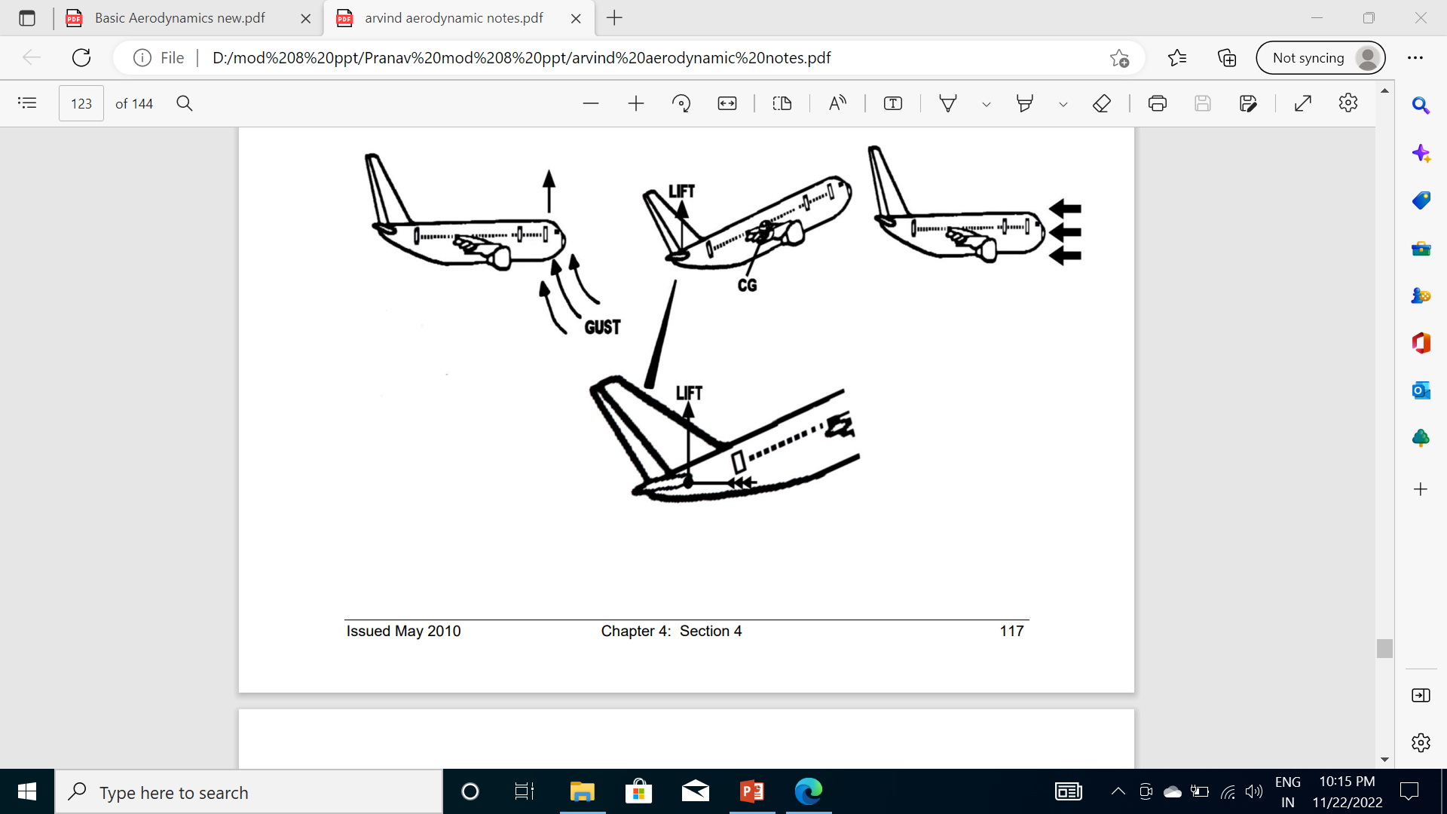

Slide 36
In this nose up attitude, the angle of attack on both the mainplane and the tailplane is increased, which will produce lift on both surfaces.
The effect of the increase in lift on the mainplane being to try and increase the aircraft’s nose up attitude, as its centre of pressure moves forward.
At the same time however, the increase in angle of attack on the tailplane will create lift on the upper surface of the tailplane producing an upload that overcomes both the disturbance and the additional lift of the wings, to produce overall a nose-down pitching moment that will restore the aircraft to its original attitude.

Slide 37
The degree of longitudinal stability of an aircraft therefore, is depends upon the size of the restoring moment provided by the tailplane, which is determined mainly by:
The length of the longitudinal moment arm.
Size and shape of the tailplane or horizontal stabiliser.

Slide 38
Length of the Longitudinal Moment Arm
The longitudinal moment arm of an aircraft is the distance measured from the aircraft’s centre of gravity to the centre of pressure of the tailplane (Cp tail). This affects the longitudinal stability of an aircraft, as the aircraft pitches about the centre of gravity

Slide 39
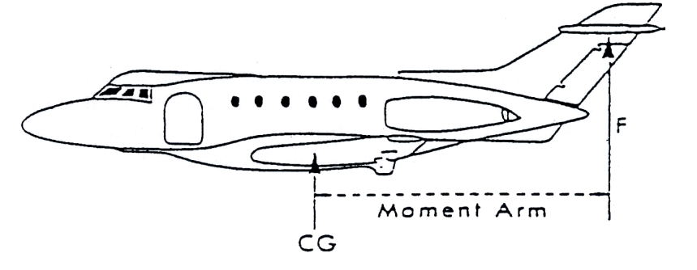

Slide 40
Any movement of the centre of gravity will either increase or decrease the length of the moment arm, which will affects the longitudinal stability of an aircraft, as it will alter the size of the restoring moment.
Generally the further forward the centre of gravity is, the greater will be the aircraft stability, but since a high level of stability results in poor controllability. The further forward is the centre of gravity is, the greater will be the stick force necessary to manoeuvre the aircraft. An aircraft therefore reaches a point where the stick force becomes excessively large and the aircraft becomes difficult to manoeuvre, especially at low speeds where it would become uncontrollably nose heavy.

Slide 41
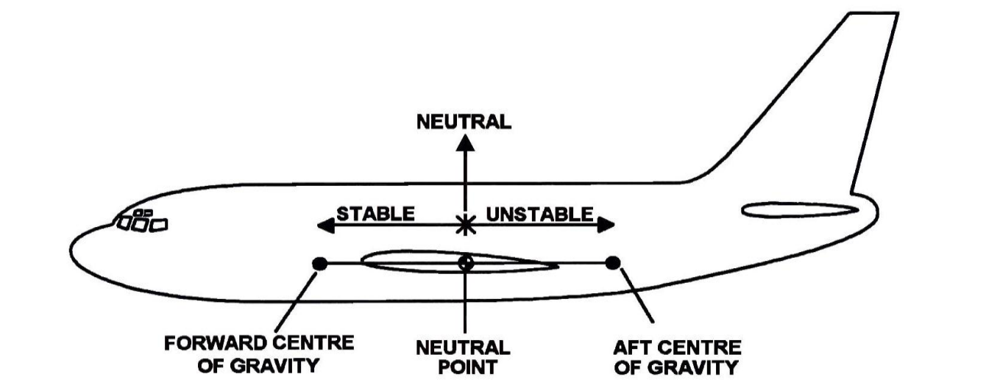

Slide 42
The final position of the centre of gravity is the rear or aft position. This is the furthest rearward position of the centre of gravity that the controls surfaces can return the aircraft back to level flight, so any movement of the centre of gravity beyond this point would mean that if disturbed an aircraft would not be able to return to level flight and would continue to diverge.

Slide 43
As most aircraft however are designed to be longitudinally statically stable, the range of movement of the centre of gravity is confined to between the forward centre of gravity and a point just ahead of the neutral point, this is known as the static margin or C of G margin of an aircraft, and ensures that an aircraft after a disturbance can return to level flight without pilot assistance.

Slide 44
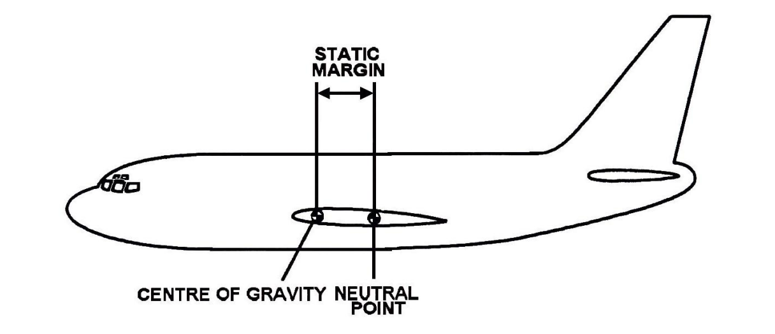

Slide 45
The size of the static margin for an aircraft is given in the aircraft manual and will vary greatly between different types of aircraft. For example, on some military aircraft the CG margin is as low as a few centimetres but on large passenger aircraft it can be greater than a metre.

Slide 46
Size and Shape of the Tailplane or Horizontal Stabiliser
Like all aerofoils, the planform size and shape of the tailplane or horizontal stabiliser will affect the amount of lift the tailplane produces at a given angle of attack.

Slide 47
Other Factors affecting Longitudinal Stability
In a disturbance, other factors that affect the longitudinal stability of an aircraft are:
Size and shape of the keel surface rear of the centre of gravity.
Position of the tail plane.
Stick free surfaces.

Slide 48
LATERAL STABILITY (ROLLING)
Stability about the aircraft's longitudinal axis, which extends from the nose of the aircraft to its tail, is called lateral stability.
This helps to stabilize the lateral or "rolling effect" when one wing gets lower than the wing on the opposite side of the aircraft.
There are four main design factors that make an aircraft laterally stable: dihedral, sweepback, keel effect, and weight distribution.

Slide 49
DIHEDRAL
The most common procedure for producing lateral stability is to build the wings with an angle of one to three degrees above perpendicular to the longitudinal axis.
The wings on either side of the aircraft join the fuselage to form a slight V or angle called "dihedral." The amount of dihedral is measured by the angle made by each wing above a line parallel to the lateral axis.

Slide 50
Dihedral involves a balance of lift created by the wings' AOA on each side of the aircraft's longitudinal axis.
If a momentary gust of wind forces one wing to rise and the other to lower, the aircraft banks. When the aircraft is banked without turning, the tendency to sideslip or slide downward toward the lowered wing occurs.

Slide 51
Since the wings have dihedral, the air strikes the lower wing at a much greater AOA than the higher wing. The increased AOA on the lower wing creates more lift than the higher wing.
Increased lift causes the lower wing to begin to rise upward. As the wings approach the level position, the AOA on both wings once again are equal, causing the rolling tendency to subside. The effect of dihedral is to produce a rolling tendency to return the aircraft to a laterally balanced flight condition when a sideslip occurs.

Slide 52
SWEEPBACK
Sweepback is an addition to the dihedral that increases the lift created when a wing drops from the level position.
A sweptback wing is one in which the leading edge slopes backward.
When a disturbance causes an aircraft with sweepback to slip or drop a wing, the low wing presents its leading edge at an angle that is perpendicular to the relative airflow. As a result, the low wing acquires more lift, rises, and the aircraft is restored to its original flight attitude.

Slide 53
Sweepback also contributes to directional stability.
When turbulence or rudder application causes the aircraft to yaw to one side, the right wing presents a longer leading edge perpendicular to the relative airflow.
The airspeed of the right wing increases and it acquires more drag than the left wing. The additional drag on the right wing pulls it back, turning the aircraft back to its original path.

Slide 54
KEEL EFFECT/WEIGHT DISTRIBUTION
An aircraft always has the tendency to turn the longitudinal axis of the aircraft into the relative wind.
This "weather vane" tendency is similar to the keel of a ship and exerts a steadying influence on the aircraft laterally about the longitudinal axis.
When the aircraft is disturbed and one wing dips, the fuselage weight acts like a pendulum returning the airplane to its original attitude. Laterally stable aircraft are constructed so that the greater portion of the keel area is above and behind the CG.

Slide 55
Thus, when the aircraft slips to one side, the combination of the aircraft's weight and the pressure of the airflow against the upper portion of the keel area (both acting about the CG) tends to roll the aircraft back to wings level flight

Slide 56
Wing Dihedral
Lateral stability of an aircraft is often referred to as the ‘dihedral affect’, as when an aircraft sideslips, an aircraft with a dihedral wing will quickly recover to a wing level position. This occurs because as an aircraft sideslips, the lower wing due to the dihedral will have a higher angle of attack to the sideslip relative airflow, than the upper wing, so will produce lift in addition to the inbuilt damping affect, which will restore the aircraft back to a wing level condition.

Slide 57
The larger the amount of wing dihedral therefore, the higher will be the lateral rolling stability. Conversely if an aircraft is designed with the wings at an anhedral angle, the opposite effect occurs and the aircraft becomes less stable in a lateral disturbance.

Slide 58
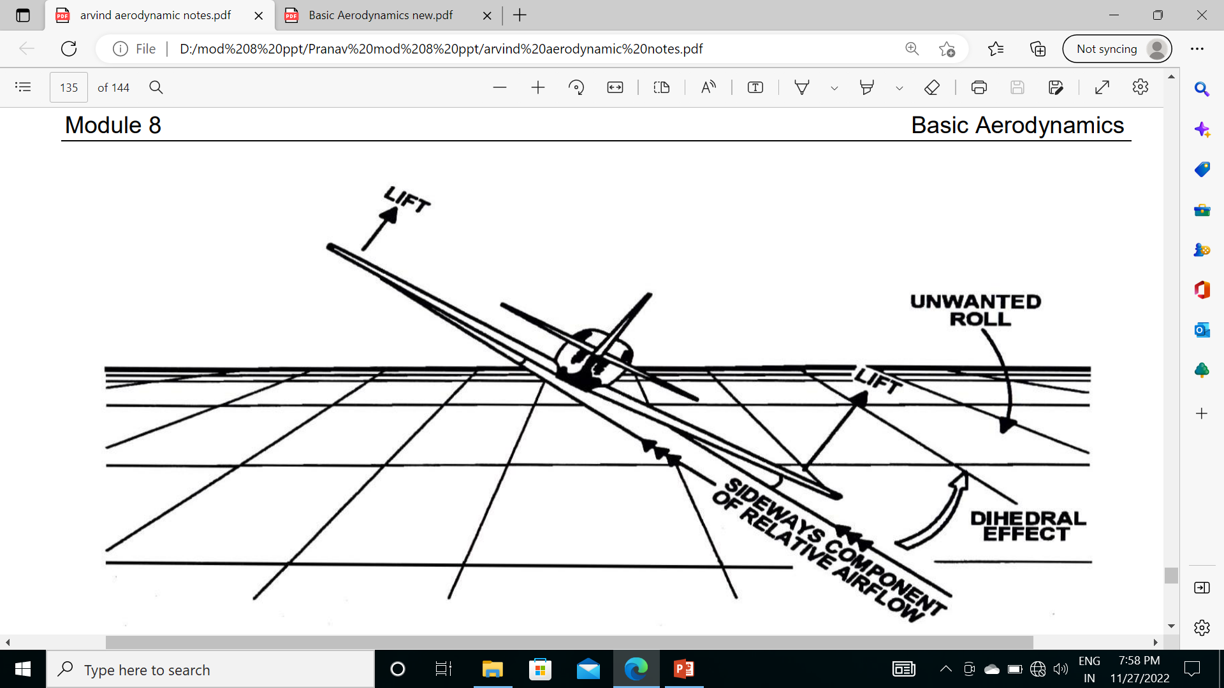

Slide 59
DIRECTIONAL STABILITY (YAWING)
Stability about the aircraft's vertical axis (the sideways moment) is called yawing or directional stability.
Yawing or directional stability is the most easily achieved stability in aircraft design.
The area of the vertical fin and the sides of the fuselage aft of the CG are the prime contributors which make the aircraft act like the well known weather vane or arrow, pointing its nose into the relative wind

Slide 60
In examining a weather vane, it can be seen that if exactly the same amount of surface were exposed to the wind in front of the pivot point as behind it, the forces fore and aft would be in balance and little or no directional movement would result.
Similarly, the aircraft designer must ensure positive directional stability by making the side surface greater aft than ahead of the CG.
To provide additional positive stability to that provided by the fuselage, a vertical fin is added.

Slide 61
The fin acts similar to the feather on an arrow in maintaining straight flight. Like the weather vane and the arrow, the farther aft this fin is placed and the larger its size, the greater the aircraft's directional stability.

Slide 62
If an aircraft is flying in a straight line, and a sideward gust of air gives the aircraft a slight rotation about its vertical axis (e.g., the right), the motion is retarded and stopped by the fin because while the aircraft is rotating to the right, the air is striking the left side of the fin at an angle.
This causes pressure on the left side of the fin, which resists the turning motion and slows down the aircraft's yaw.

Slide 63
In doing so, it acts somewhat like the weather vane by turning the aircraft into the relative wind.
The initial change in direction of the aircraft's flightpath is generally slightly behind its change of heading.
Therefore, after a slight yawing of the aircraft to the right, there is a brief moment when the aircraft is still moving along its original path, but its longitudinal axis is pointed slightly to the right.

Slide 64
The aircraft is then momentarily skidding sideways, and during that moment (since it is assumed that although the yawing motion has stopped, the excess pressure on the left side of the fin still persists) there is necessarily a tendency for the aircraft to be turned partially back to the left. There is a momentary restoring tendency caused by the fin.

Slide 65
A minor improvement of directional stability may be obtained through sweepback.
A longitudinally stable aircraft is built with the center of pressure aft of the CG.
By building sweepback into the wings, however, the designers can move the center of pressure toward the rear. The amount of sweepback and the position of the wings then place the center of pressure in the correct location.

Slide 66
FREE DIRECTIONAL OSCILLATIONS (DUTCH ROLL)
Dutch roll is a coupled lateral/directional oscillation that is usually dynamically stable but is unsafe in an aircraft because of the oscillatory nature.
A Dutch roll is a combination of rolling and yawing oscillations that occurs when the dihedral effects of an aircraft are more powerful than the directional stability.

Slide 68
Dutch roll stability can be artificially increased by the installation of a yaw damper.
A yaw damper (sometimes referred to as a stability augmentation system) is a system used to reduce (or damp) the undesirable tendencies of an aircraft to oscillate in a repetitive rolling and yawing motion, a phenomenon known as the Dutch roll.

Slide 69
PASSIVE AND ACTIVE STABILITY
The term "Passive Stability" refers to a situation in which the vehicle is naturally (inherently) stable and does not require any artificial stabilization systems. This would require positive static stability and positive dynamic stability

Slide 70
The term "Active Stability" refers to the use of artificial stabilizing systems to improve the handling of vehicles which do not exhibit sufficient passive stability. An example of such a system would be an aircraft automatic stabilization system (Basic Autopilot)

Slide 71
STICK SHAKER
A stick shaker is a mechanical device designed to rapidly and noisily vibrate the control yoke (the "stick") of an aircraft, warning the flight crew that an imminent aerodynamic stall has been detected. It is typically present on the majority of large civil jet aircraft, as well as most large military planes.
The stick shaker comprises a key component of an aircraft's stall protection system.

Slide 72
STICK PUSHER
Other stall protection systems include the stick pusher, a device that automatically pushes forward on the control yoke, commanding a reduction in the aircraft's angle of attack and thus preventing the aircraft from entering a full stall.
In the majority of circumstances, the stick pusher will not activate until shortly after the stick shaker has given its warning of near-stall conditions being detected, and won't activate if the flight crew have performed appropriate actions to reduce the likelihood of stalling by lowering the angle of attack.

Slide 73
Electronic Flight Instrument System (EFIS)
An electronic flight instrument system (EFIS) is a flight deck instrument display system in which the display technology used is electronic rather than electromechanical.
. EFIS normally consists of a primary flight display (PFD), multi-function display (MFD) and engine indicating and crew alerting system (EICAS) display.
Although cathode ray tube (CRT) displays were used at first, liquid crystal displays (LCD) are now more common.

Slide 74
A light aircraft might be equipped with one display unit, on which flight and navigation data are displayed.
A wide-body aircraft is likely to have six or more display units. An EFIS installation will follow the sequence:
• Displays • Controls • Data processors
A basic EFIS might have all these facilities in the one unit.

Slide 75
GLASS COCKPIT
A glass cockpit is an aircraft cockpit that features electronic (digital) flight instrument displays, typically large LCD screens, rather than the traditional style of analog dials and gauges.

Slide 76
THANK YOU
Prepared By :
Mr. Pranav Thorave
Hindustan Aerospace And Engineering Pune.

